Slide 1
CAMP GUYASUTA FIELDTRIP
HIGH LEVEL CHALLENGE COURSE
LOW LEVEL CHALLENGE COURSE
COOPERATIVE/TRUST ACTIVITIES

Slide 2
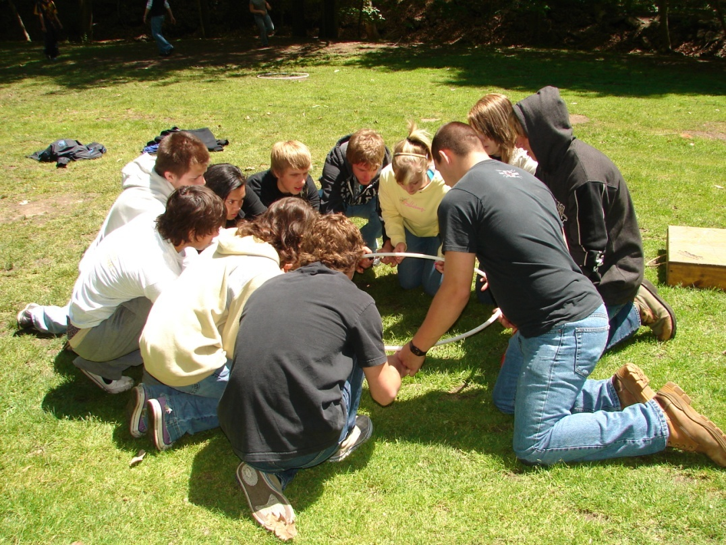
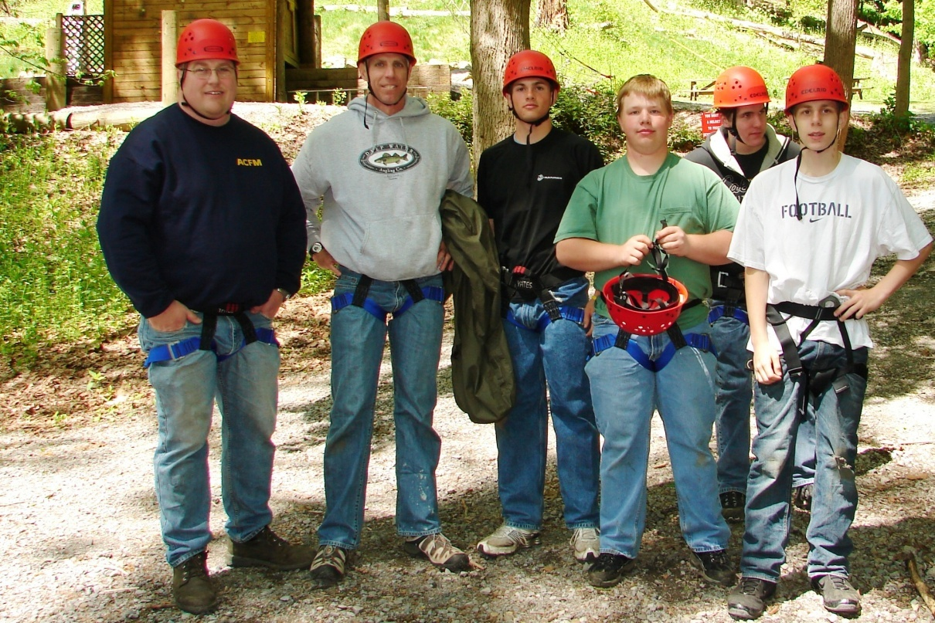
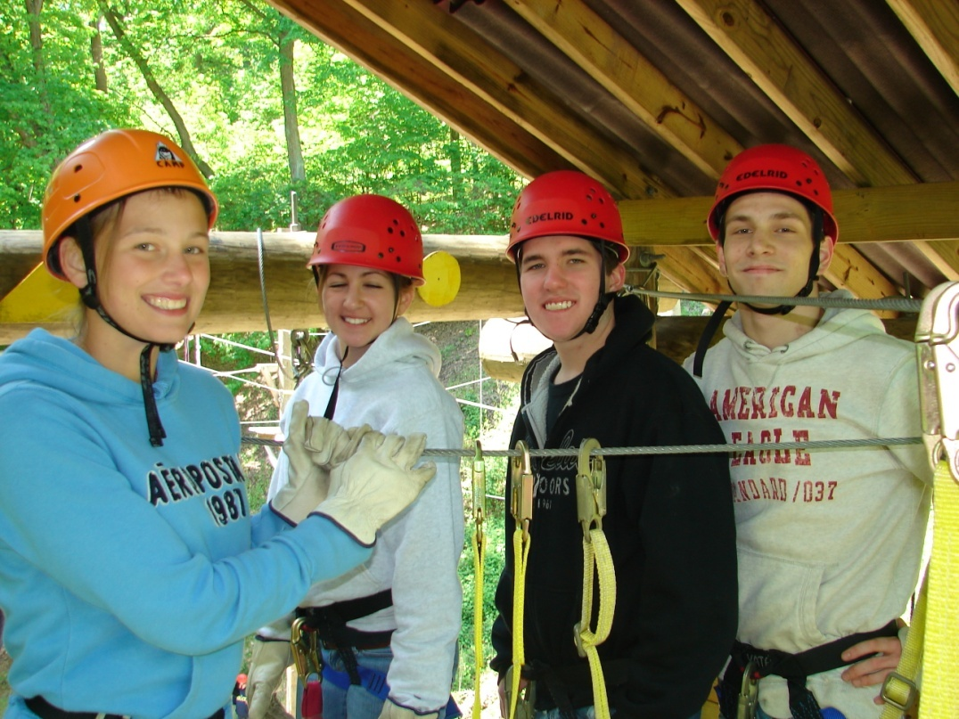
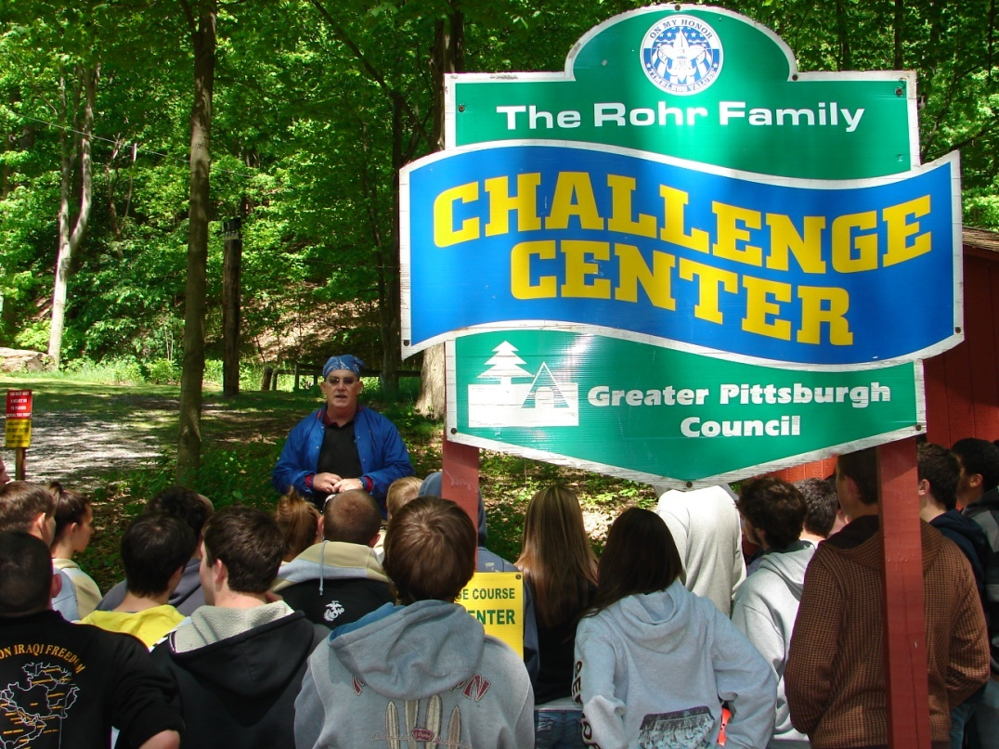
THE GUYASUTA EXPERIENCE EMPHASIS
COOPERATION
TEAMWORK
STRATEGY
COMMUNICATION
RESPONSIBILITY
RESPECT
CHOICE
LEADERSHIP
GROUP DYNAMICS
GROUP COHESION

Slide 3
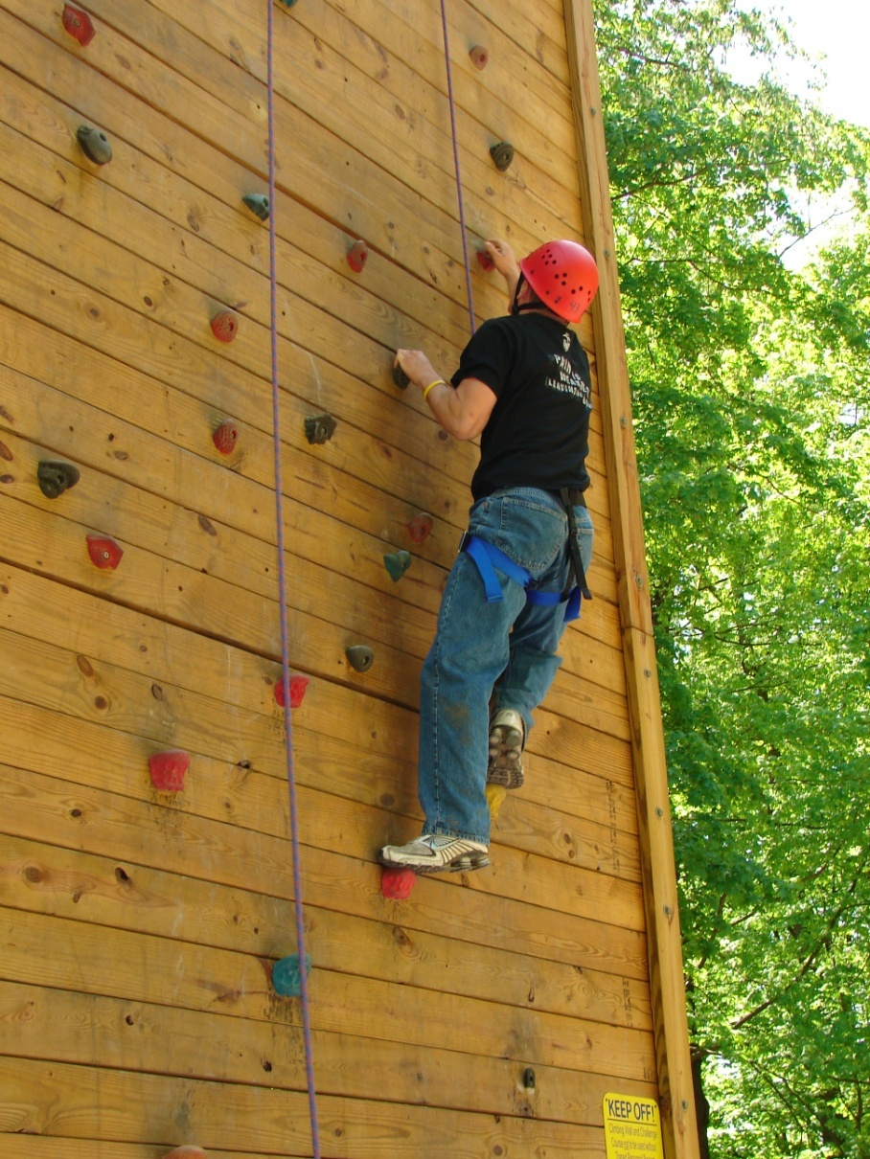
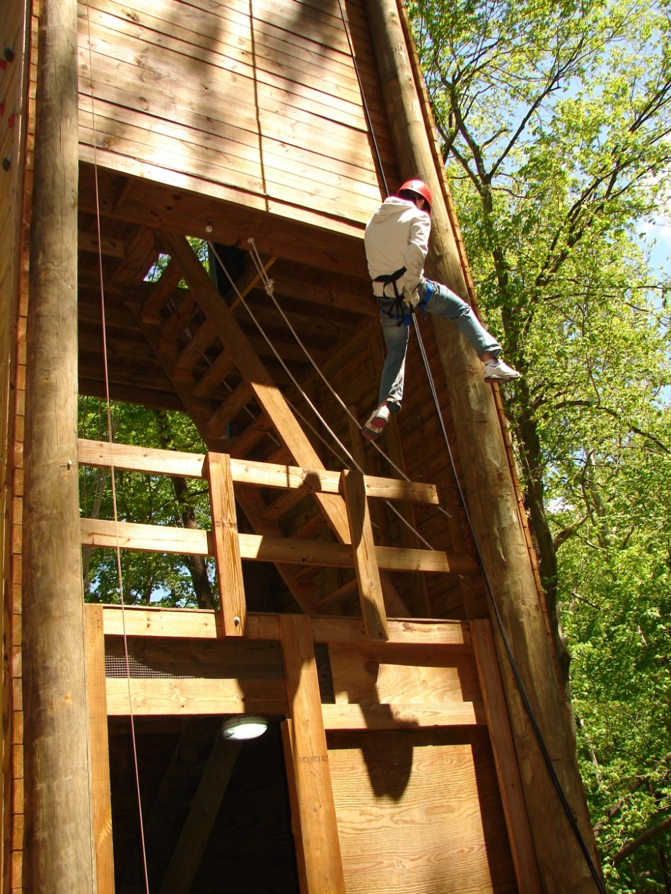
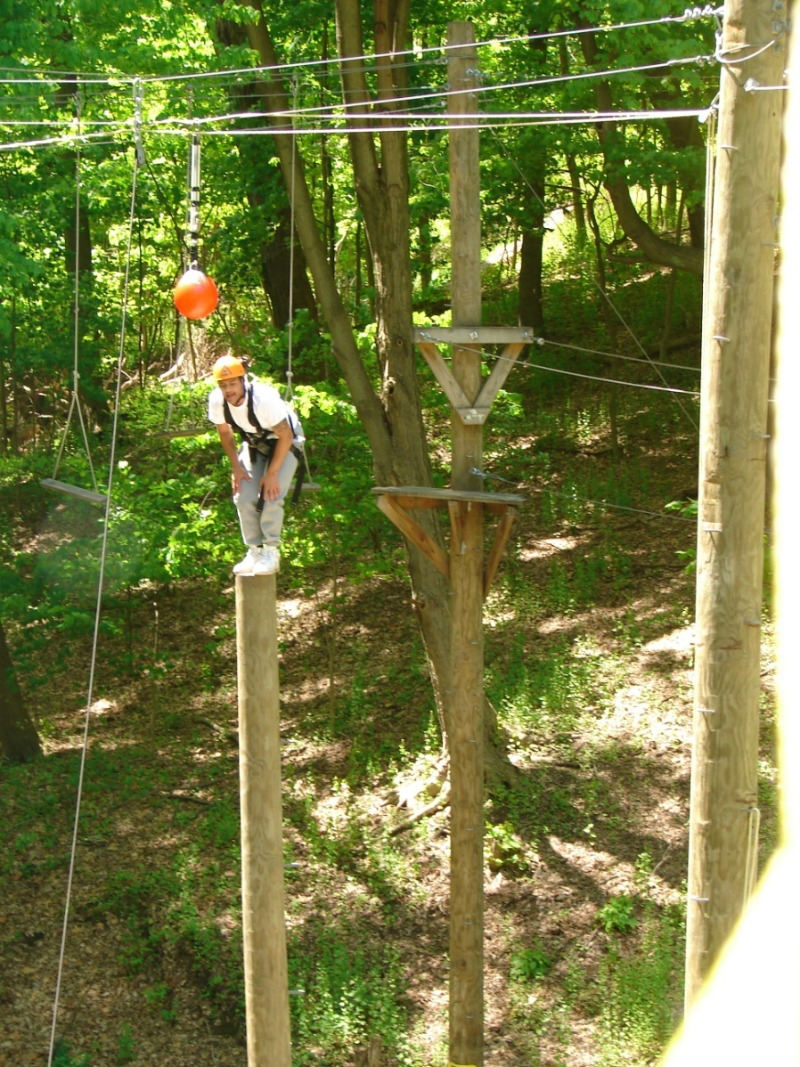
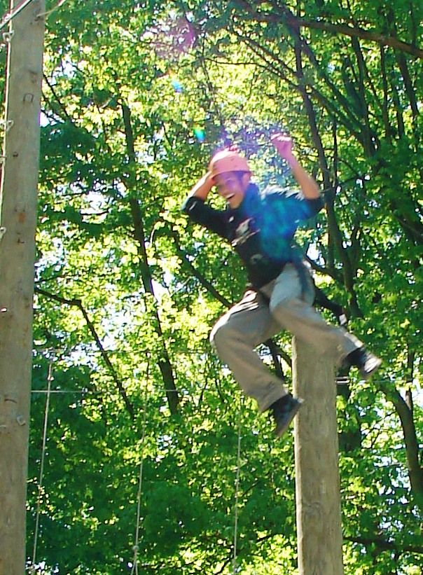
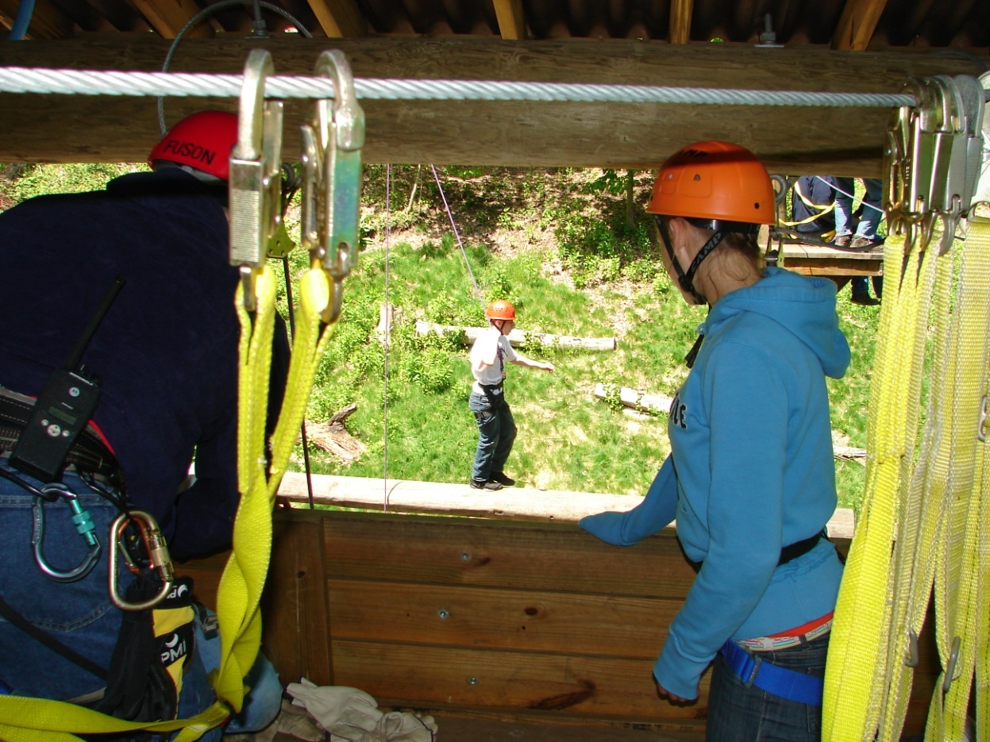
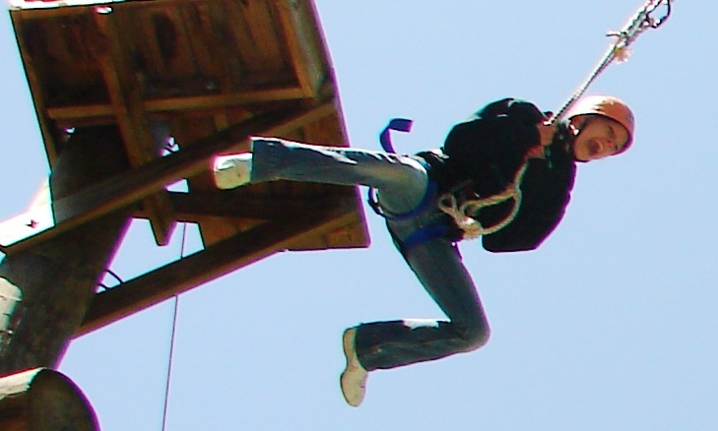
HIGH LEVEL CHALLENGE COURSE
“ON BELAY.”
“BELAY ON.”
“READY TO CLIMB.”
“CLIMB ON.”

Slide 4
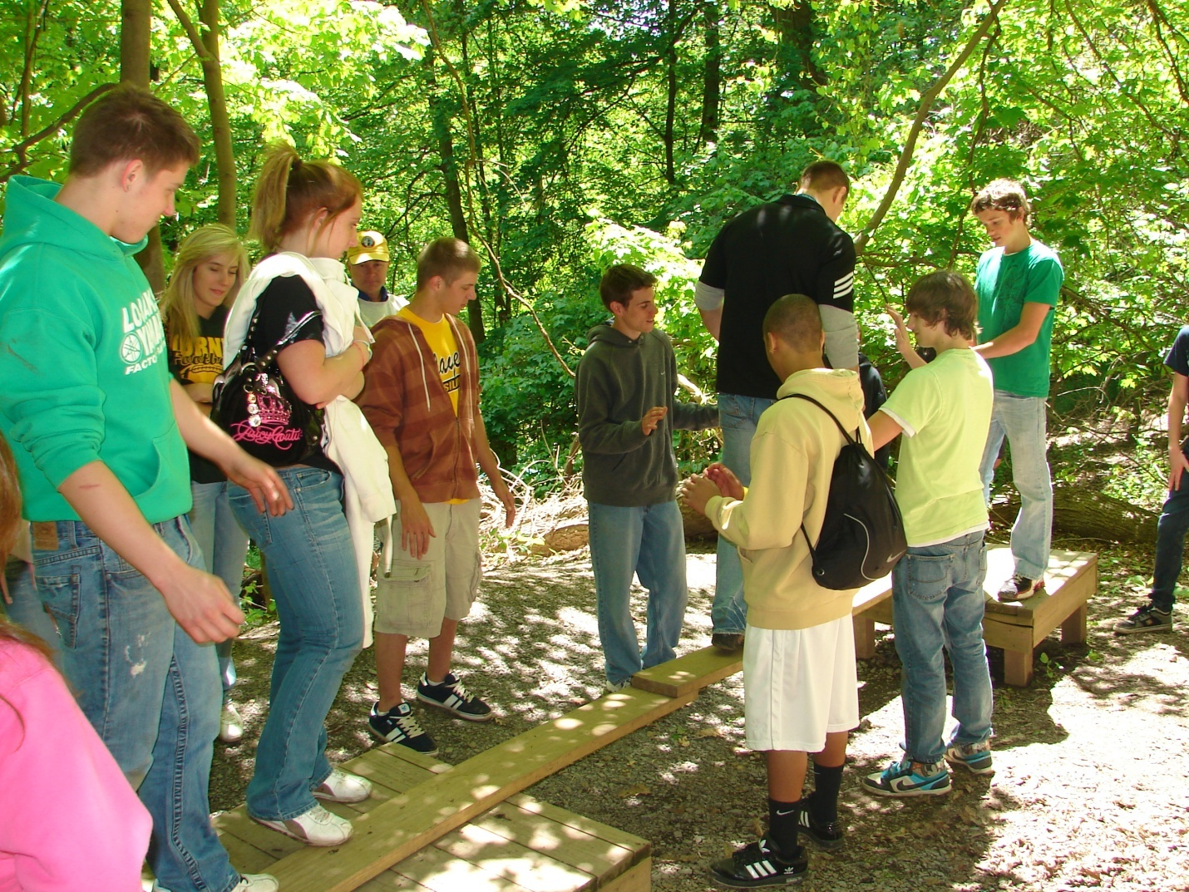
LOW LEVEL CHALLENGE COURSE
ARCHIMEDES BRIDGE

Slide 5
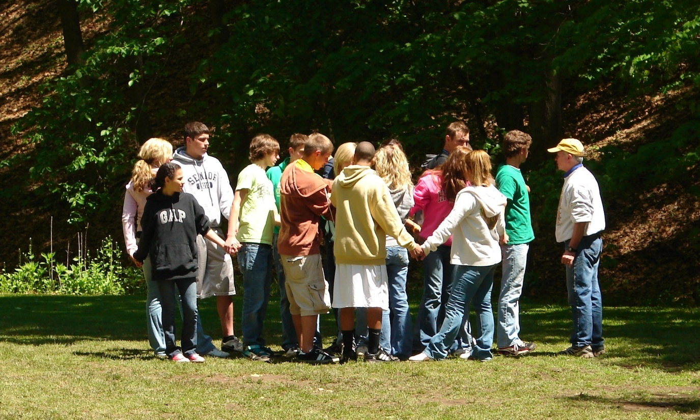
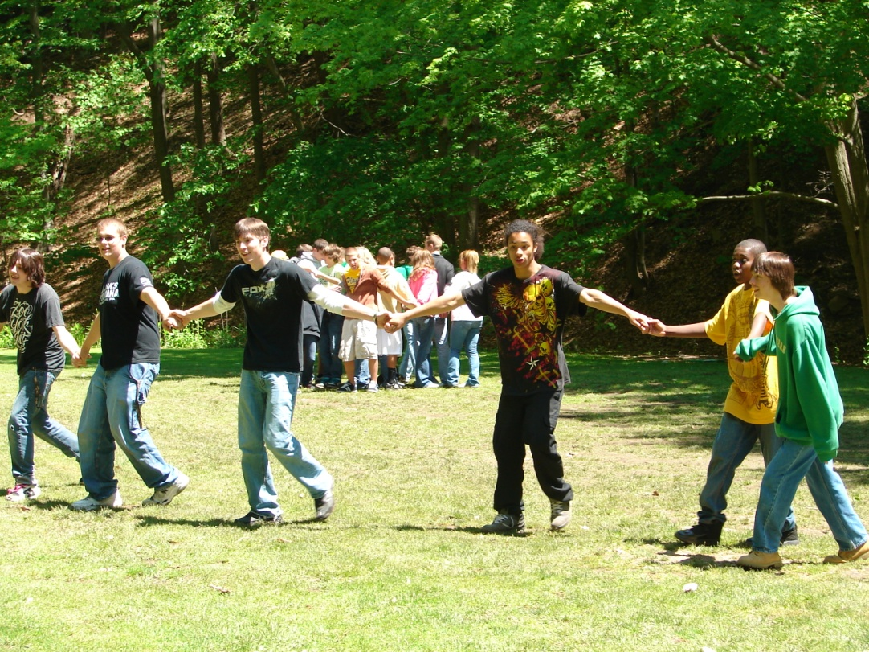
COOPERATIVE/ TRUST ACTIVITIES
HUMAN KNOT
HUMAN SPRING
TRUST FALL
TRUST LEAN
BLIND TRUST WALK
GROUP JUGGLE
HUMAN TABLE

Slide 6
FIRE SERVICE TRAINING CLASS REMARKS
“Awesome, one of the best field trips I have ever been on.” Steve Negrich
“Amazing team building exercises.” Steve Rea
“These activities are paramount in the fire service, and this field trip and its lessons supported what we are trying to accomplish.” Mike Krzeminski (Instructor)

Slide 7
STUDENT'S THOUGHTS
“THIS WAS SOMETHING REALLY NEW AND INTERESTING TO TRY IN A PE CLASS.” NATALIE CASSONI (12TH GRADE)
“I WAS ABLE TO CONQUER MY FEAR OF HEIGHTS WHILE CREATING NEW FRIENDSHIPS.” MAX PALMER (10TH GRADE)

Slide 8
OUR GOALS AND OBJECTIVES
SHORT TERM
IMPLEMENT CHALLENGE/TRUST ACTIVITIES INTO SUMMER 2010 PE CURRICULUM
LONG TERM
IMPLEMENT CHALLENGE/TRUST ACTIVITIES INTO GENERAL ANNUAL PE CURRICULM
CONSTRUCTION OF FIRE TRAINING TOWER ON HIGHLANDS CAMPUS
CONSTRUCTION OF HIGH AND LOW LEVEL ROPES COURSE ON HIGHLANDS CAMPUS

Slide 9
PLEASE ASK QUESTIONS.
THANK YOU FOR YOUR TIME
PATRICK POLCHA
CHARLES DEBOR
*HEALTH AND PE DEPARTMENT STAFF

